Slide 1

POVs & Experience Prototypes

Slide 2
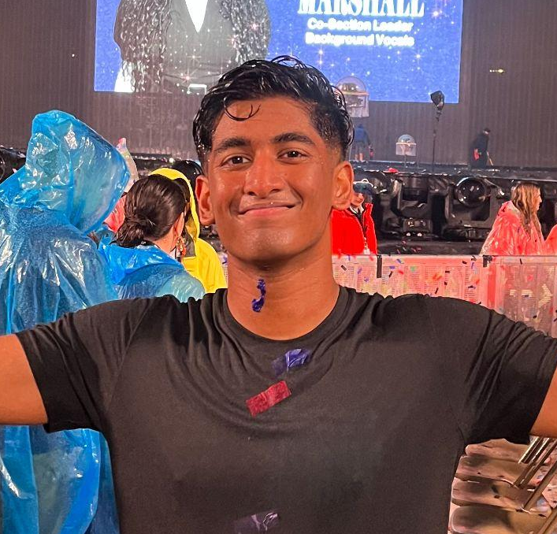
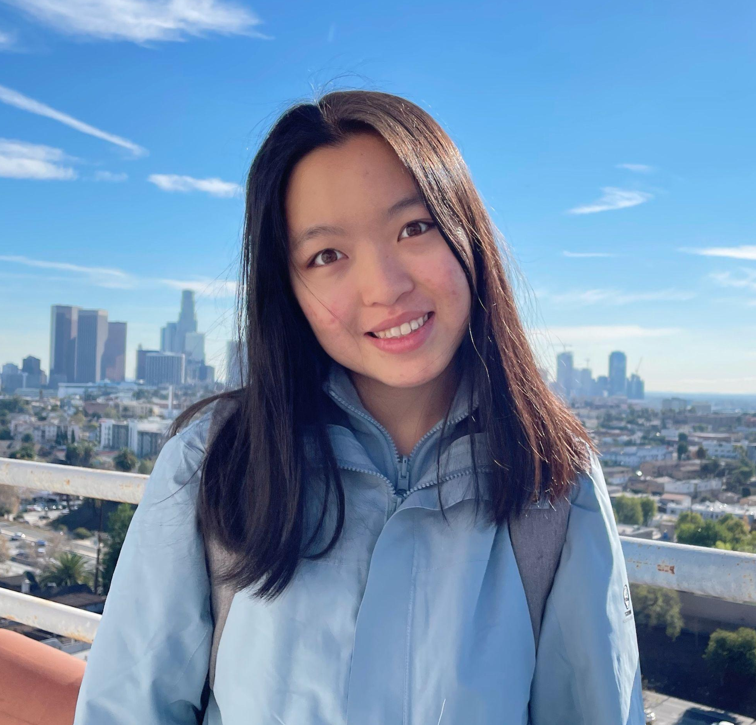
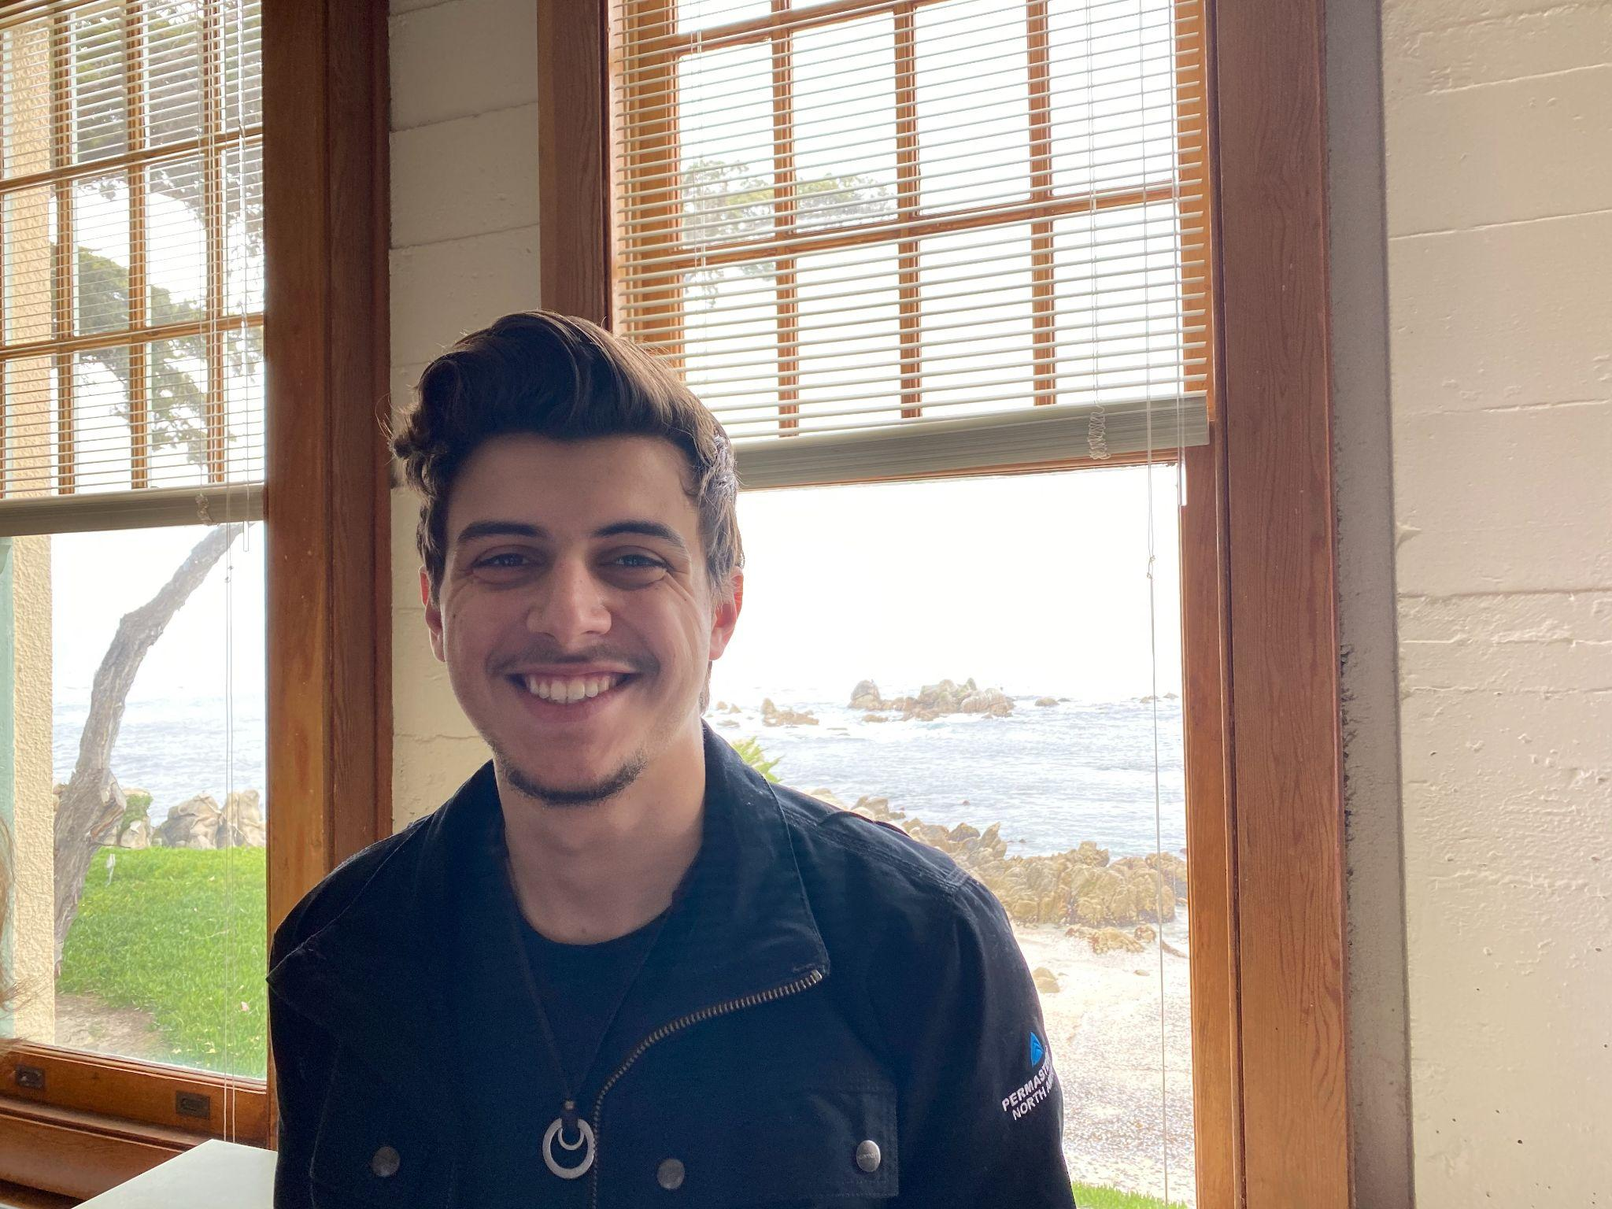
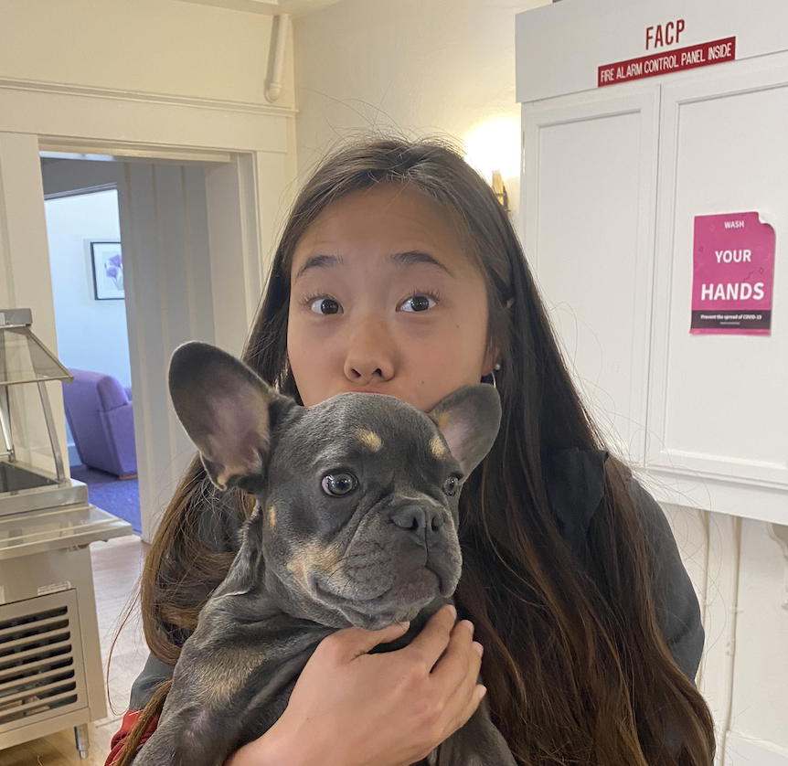
Meet Our Team
Allen Naliath
Charlotte Zhu
Francis Santiago
Yishu Chen
‘25
Boston, MA
‘25
Suzhou, China
‘23/’24
Miami, FL
‘23/’24
Hong Kong

Slide 3
Narrowing Down Domain
01
Reflected on personal needs and experiences to kickoff project
Reflection
02
Explored both lost and found and media entertainment realms during interviews
Exploration
03
Decided there is more interest and need surrounding entertainment/media
Decision
04
Observed that entertainment media revolved around video content
Focus
Notes:
Reflecting on personal needs and experiences. What domains do we know of that could use innovation?
Stuck between two very different domains. In-depth exploration of both ensued.
Exploration of existing products in entertainment. Using information from interviews to see what needs were most salient.
Identified a gap in existing products and in the needs of the individuals we interviewed. Chose a domain that has the greatest potential for exploration.

Slide 4
More Interviews

Slide 5
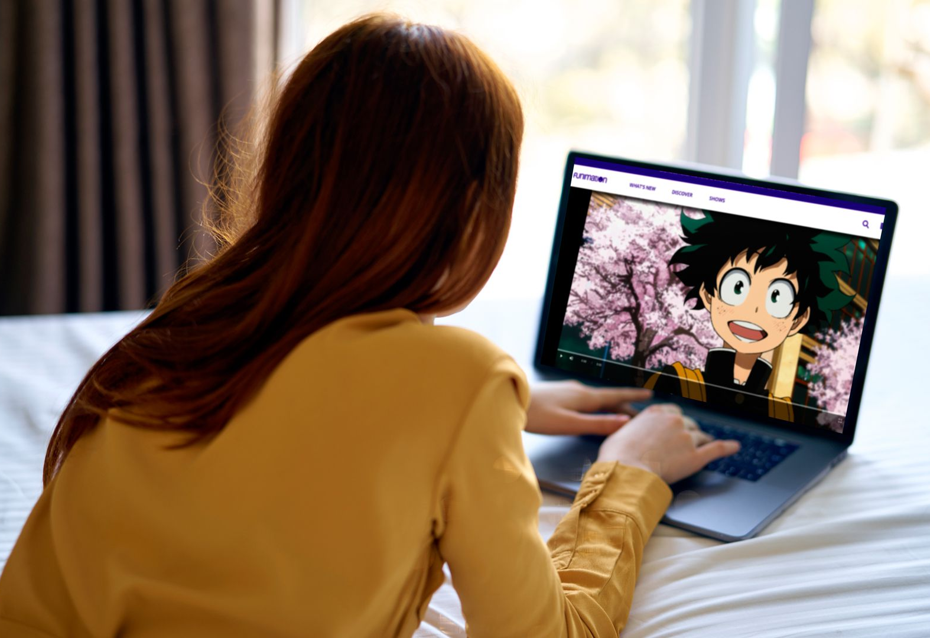


Finding MORE Participants
Young Extreme User
Expert
Expand Users’ Age Range
Acquire Professional Views
Notes:
try to encounter people with diverse backgrounds
have an extreme user in mind and scheduled a meeting

Slide 6
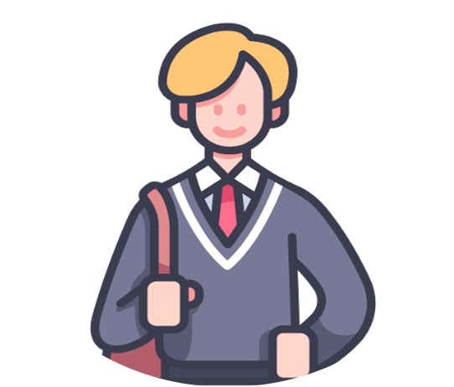
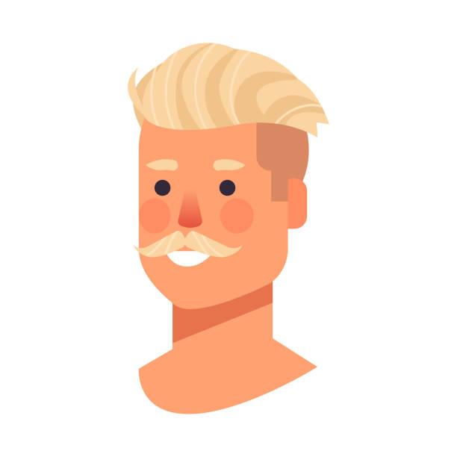
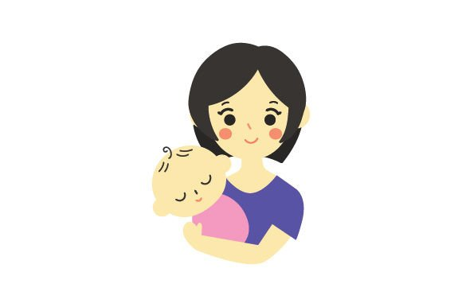
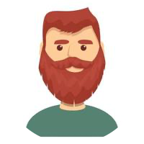

Julian
17-yr-old
high school student
Palo Alto
Last time we interviewed…
David
Zirui
Collin
DJ
52
commercials at a solar panel company
Palo Alto
32
chemical instrument company
Mountain View
35
college admissions consultant
32
residential director
@ Stanford
Abby
Julian
Non-User
Extreme User
Almost Never Use
Always Use
Notes:
A total of 6 interviews
We chose 4 to analyze in detail
Ranging from non-user (almost never consume media) to extreme user (consume media very frequently)

Slide 7


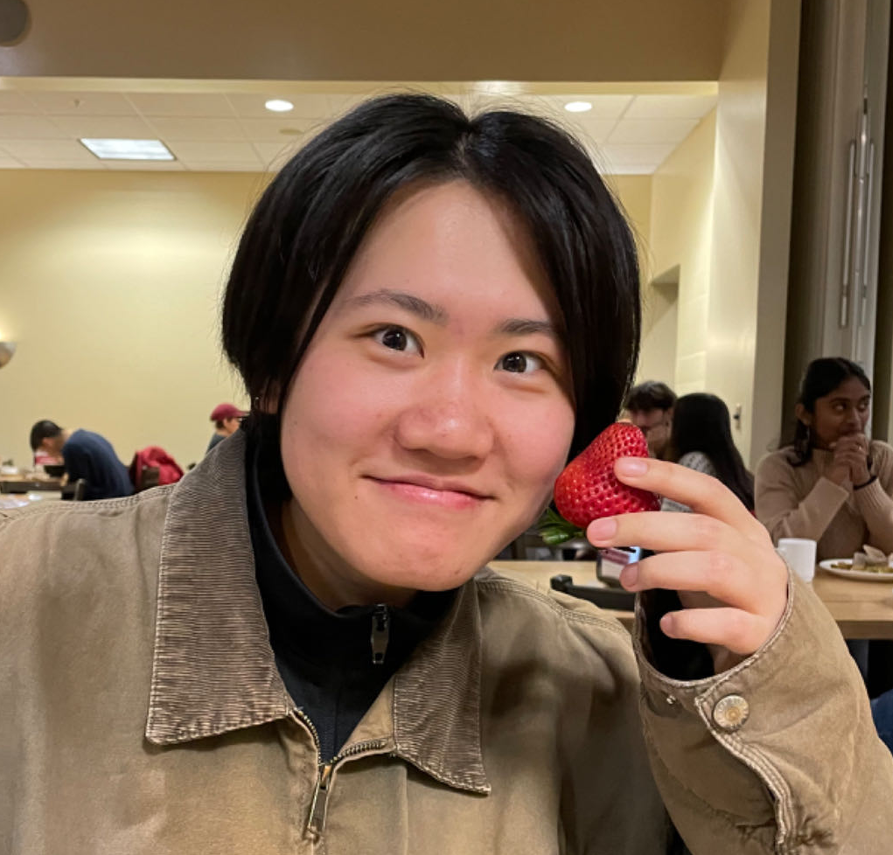


Julian
17-yr-old
high school student
Palo Alto
This time we interviewed…
Rene
Danielle
Sera
Aaron
Deba
late 30s
NPD @ Stanford, Star Wars and wrestling media enthusiast from Mexico
early 30s
RD @ Stanford, avid football watcher from Colorado
19
Complit Student & manga lover from China
22
Aspiring doctor & sitcom lover from Indiana
22
Humbio TA & reality TV lover from Texas
Non-User
Extreme User
Almost Never Use
Always Use
Notes:
A total of 6 interviews
We chose 4 to analyze in detail
Ranging from non-user (almost never consume media) to extreme user (consume media very frequently)

Slide 8
More Insights

Slide 9
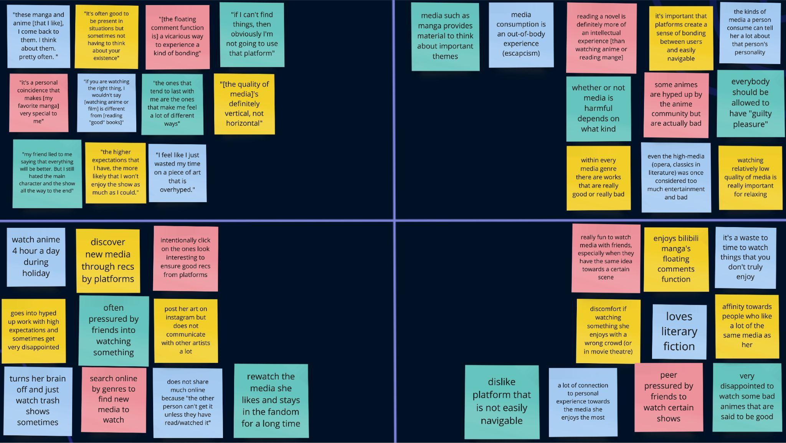
Say
Think
Do
Feel

Slide 10
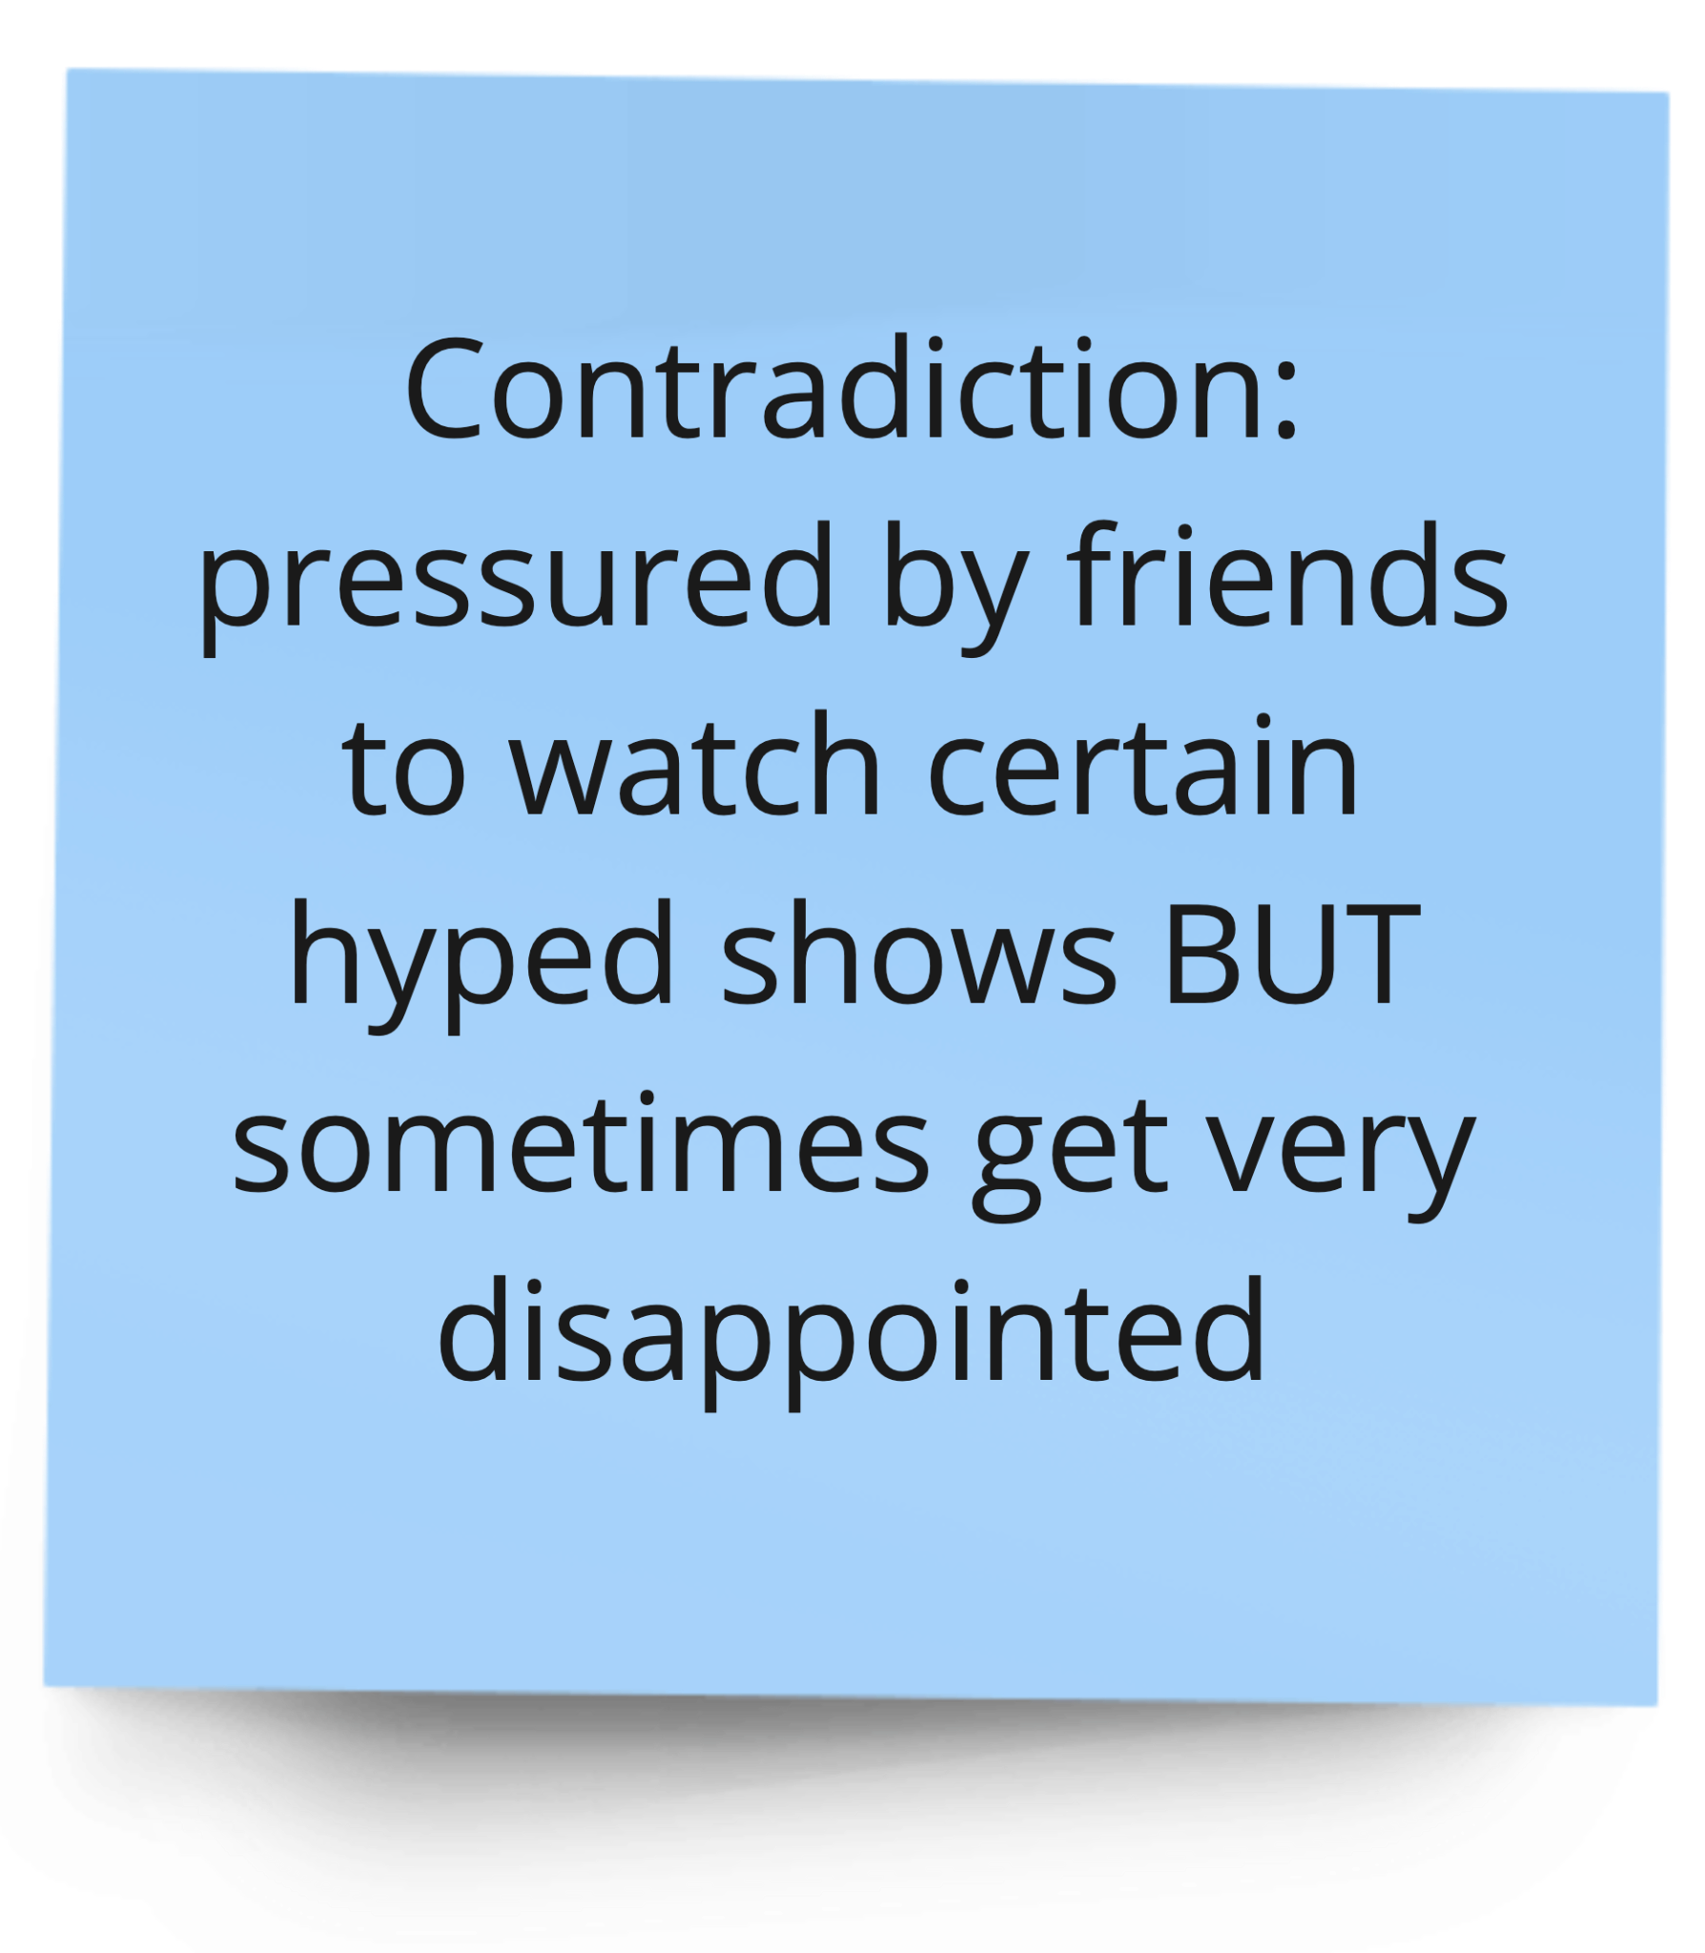
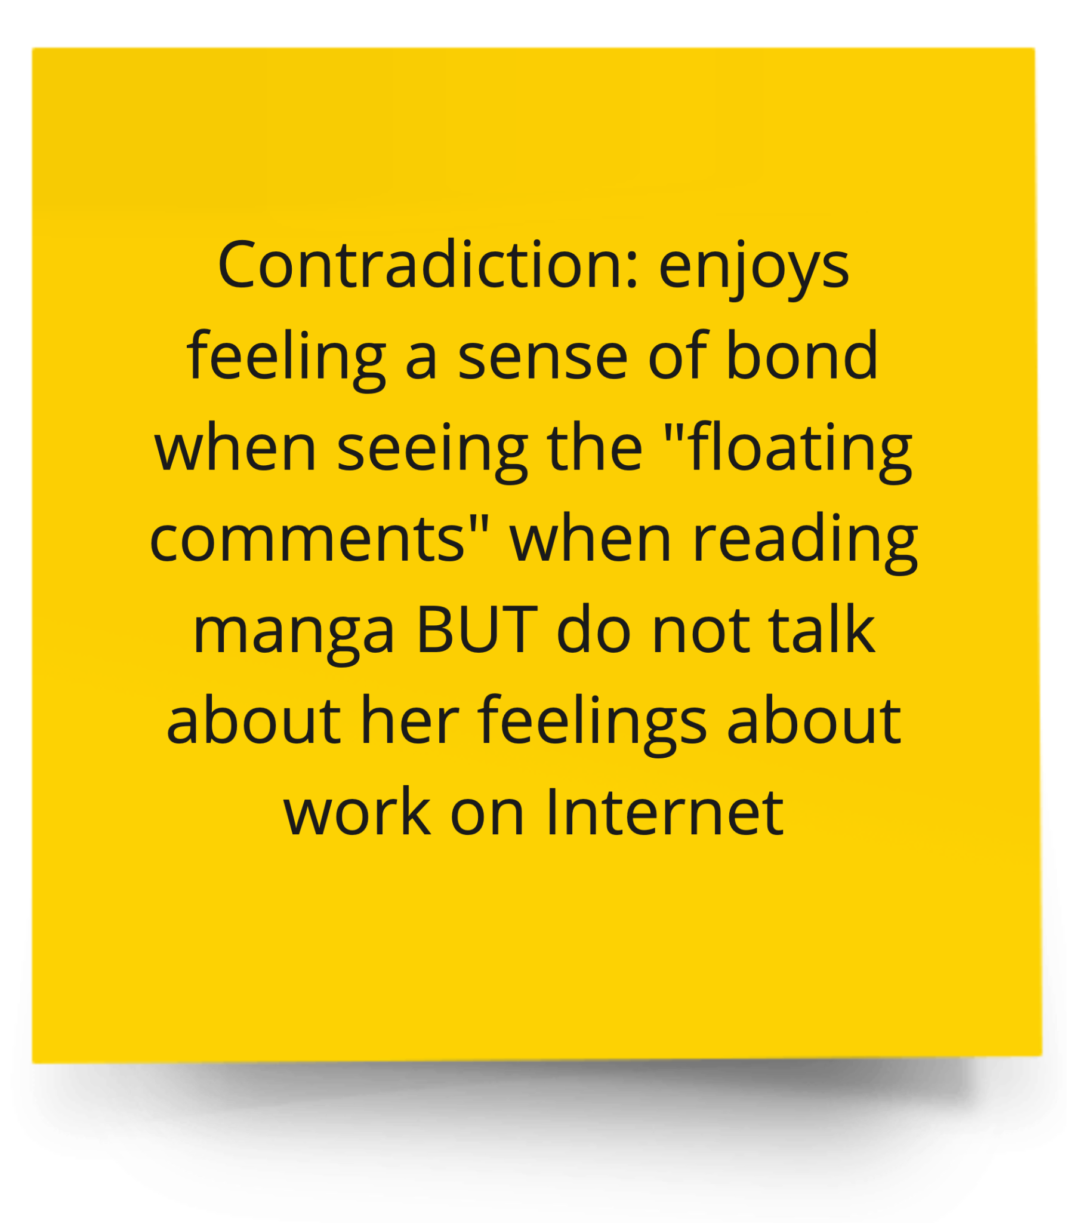
Insights
Needs
People wish to have a sense of bonding or community when consuming media. The quality of that community matters a lot.
People wish to have a less stressful way to share about their personal experience and interact with people who share their passion.

Slide 11
POVs

Slide 12
POV ~ David
Notes:
FILTER CONTENT
HMW filter out irrelevant content?
HMW make sorting through content effortless?
HMW ensure users find their passion-related content amidst the digital noise?
LEARN MORE ABOUT CONTENT
HMW know what types of video people find interesting/uninteresting?
HMW learn more about content he is currently exposed to?
EXPOSURE TO NEW/OTHER CONTENT
HMW make David & others like him open to different kinds of content?
HMW make David & others like him passionate about other things?
GENERAL MEDIA
HMW make non-engagement with digital media undesirable?
HMW get rid of some of the stigma around consuming media (vs being outdoorsy)?
COMMUNITY
HMW give him another way to interact with content or individuals who share this passion?
MAKE MEDIA EXPERIENCE MORE POSITIVE/INTEGRATED INTO HIS LIFE
HMW make media consumption more enjoyable for outdoorsy people?
HMW reframe general media consumption as a good thing that is worth his time?
HMW ensure that the digital experience is enriching for everyone?
HMW have media consumption not interfere with outdoor time?

Slide 13
POV ~ David
WE MET David, an outdoorsy skateboarding enthusiast who claims to be “social media anti-social” and didn’t carry any electronics with him.
Notes:
FILTER CONTENT
HMW filter out irrelevant content?
HMW make sorting through content effortless?
HMW ensure users find their passion-related content amidst the digital noise?
LEARN MORE ABOUT CONTENT
HMW know what types of video people find interesting/uninteresting?
HMW learn more about content he is currently exposed to?
EXPOSURE TO NEW/OTHER CONTENT
HMW make David & others like him open to different kinds of content?
HMW make David & others like him passionate about other things?
GENERAL MEDIA
HMW make non-engagement with digital media undesirable?
HMW get rid of some of the stigma around consuming media (vs being outdoorsy)?
COMMUNITY
HMW give him another way to interact with content or individuals who share this passion?
MAKE MEDIA EXPERIENCE MORE POSITIVE/INTEGRATED INTO HIS LIFE
HMW make media consumption more enjoyable for outdoorsy people?
HMW reframe general media consumption as a good thing that is worth his time?
HMW ensure that the digital experience is enriching for everyone?
HMW have media consumption not interfere with outdoor time?

Slide 14
POV ~ David
WE MET David, an outdoorsy skateboarding enthusiast who claims to be “social media anti-social” and didn’t carry any electronics with him.
WE WERE SURPRISED TO FIND he doesn’t find most mainstream media interesting but claims to have seen every skateboarding crash and burn video online.
Notes:
FILTER CONTENT
HMW filter out irrelevant content?
HMW make sorting through content effortless?
HMW ensure users find their passion-related content amidst the digital noise?
LEARN MORE ABOUT CONTENT
HMW know what types of video people find interesting/uninteresting?
HMW learn more about content he is currently exposed to?
EXPOSURE TO NEW/OTHER CONTENT
HMW make David & others like him open to different kinds of content?
HMW make David & others like him passionate about other things?
GENERAL MEDIA
HMW make non-engagement with digital media undesirable?
HMW get rid of some of the stigma around consuming media (vs being outdoorsy)?
COMMUNITY
HMW give him another way to interact with content or individuals who share this passion?
MAKE MEDIA EXPERIENCE MORE POSITIVE/INTEGRATED INTO HIS LIFE
HMW make media consumption more enjoyable for outdoorsy people?
HMW reframe general media consumption as a good thing that is worth his time?
HMW ensure that the digital experience is enriching for everyone?
HMW have media consumption not interfere with outdoor time?

Slide 15
POV ~ David
WE MET David, an outdoorsy skateboarding enthusiast who claims to be “social media anti-social” and didn’t carry any electronics with him.
WE WERE SURPRISED TO FIND he doesn’t find most mainstream media interesting but claims to have seen every skateboarding crash and burn video online.
WE WONDER IF THIS MEANS even those who show little interest in media entertainment in general still love consuming content for hobbies they are truly passionate about.
Notes:
FILTER CONTENT
HMW filter out irrelevant content?
HMW make sorting through content effortless?
HMW ensure users find their passion-related content amidst the digital noise?
LEARN MORE ABOUT CONTENT
HMW know what types of video people find interesting/uninteresting?
HMW learn more about content he is currently exposed to?
EXPOSURE TO NEW/OTHER CONTENT
HMW make David & others like him open to different kinds of content?
HMW make David & others like him passionate about other things?
GENERAL MEDIA
HMW make non-engagement with digital media undesirable?
HMW get rid of some of the stigma around consuming media (vs being outdoorsy)?
COMMUNITY
HMW give him another way to interact with content or individuals who share this passion?
MAKE MEDIA EXPERIENCE MORE POSITIVE/INTEGRATED INTO HIS LIFE
HMW make media consumption more enjoyable for outdoorsy people?
HMW reframe general media consumption as a good thing that is worth his time?
HMW ensure that the digital experience is enriching for everyone?
HMW have media consumption not interfere with outdoor time?

Slide 16
POV ~ David
WE MET David, an outdoorsy skateboarding enthusiast who claims to be “social media anti-social” and didn’t carry any electronics with him.
WE WERE SURPRISED TO FIND he doesn’t find most mainstream media interesting but claims to have seen every skateboarding crash and burn video online.
WE WONDER IF THIS MEANS even those who show little interest in media entertainment in general still love consuming content for hobbies they are truly passionate about.
IT WOULD BE GAME-CHANGING IF there is a way for him to access only content that he is interested in.
Notes:
FILTER CONTENT
HMW filter out irrelevant content?
HMW make sorting through content effortless?
HMW ensure users find their passion-related content amidst the digital noise?
LEARN MORE ABOUT CONTENT
HMW know what types of video people find interesting/uninteresting?
HMW learn more about content he is currently exposed to?
EXPOSURE TO NEW/OTHER CONTENT
HMW make David & others like him open to different kinds of content?
HMW make David & others like him passionate about other things?
GENERAL MEDIA
HMW make non-engagement with digital media undesirable?
HMW get rid of some of the stigma around consuming media (vs being outdoorsy)?
COMMUNITY
HMW give him another way to interact with content or individuals who share this passion?
MAKE MEDIA EXPERIENCE MORE POSITIVE/INTEGRATED INTO HIS LIFE
HMW make media consumption more enjoyable for outdoorsy people?
HMW reframe general media consumption as a good thing that is worth his time?
HMW ensure that the digital experience is enriching for everyone?
HMW have media consumption not interfere with outdoor time?

Slide 17
HMW #1

Slide 18
How Might We…
Encourage people to break out of their typical bubbles of entertainment media consumption?

Slide 19
POV ~ Collin
Notes:
Enhance the group watching experience
HMW make it more fun to consume media as a group?
HMW make group interactions revolve around media?
HMW make media interactions revolve around groups?
HMW make it easier to watch things with friends?
Find groups for people
HMW get people regular friend groups to watch things with?
HMW make Collin feel as group-oriented about other forms of media?
HMW allow people to enjoy different types of media with different groups?
HMW help him get to know more people who are also interested in watching sports together?
Find good group-watching media
HMW figure out which types of content is more enjoyable in a social context?
HMW sort between media that’s better for group watching?
HMW make it easier for people to access media that they find most enjoyable?
HMW make all content, not just sports, sociable?
Enhance the watching experience even when alone
HMW make media consumption more enjoyable when a person’s physically alone?
HMW make a sport-watching experience fun even when the person is alone?

Slide 20
POV ~ Collin
WE MET Collin, a married middle-aged college consultant who almost exclusively consumes video content alone or with his wife.
Notes:
Enhance the group watching experience
HMW make it more fun to consume media as a group?
HMW make group interactions revolve around media?
HMW make media interactions revolve around groups?
HMW make it easier to watch things with friends?
Find groups for people
HMW get people regular friend groups to watch things with?
HMW make Collin feel as group-oriented about other forms of media?
HMW allow people to enjoy different types of media with different groups?
HMW help him get to know more people who are also interested in watching sports together?
Find good group-watching media
HMW figure out which types of content is more enjoyable in a social context?
HMW sort between media that’s better for group watching?
HMW make it easier for people to access media that they find most enjoyable?
HMW make all content, not just sports, sociable?
Enhance the watching experience even when alone
HMW make media consumption more enjoyable when a person’s physically alone?
HMW make a sport-watching experience fun even when the person is alone?

Slide 21
POV ~ Collin
WE MET Collin, a married middle-aged college consultant who almost exclusively consumes video content alone or with his wife.
WE WERE SURPRISED TO FIND that he enjoys watching sports more with a larger group of friends.
Notes:
Enhance the group watching experience
HMW make it more fun to consume media as a group?
HMW make group interactions revolve around media?
HMW make media interactions revolve around groups?
HMW make it easier to watch things with friends?
Find groups for people
HMW get people regular friend groups to watch things with?
HMW make Collin feel as group-oriented about other forms of media?
HMW allow people to enjoy different types of media with different groups?
HMW help him get to know more people who are also interested in watching sports together?
Find good group-watching media
HMW figure out which types of content is more enjoyable in a social context?
HMW sort between media that’s better for group watching?
HMW make it easier for people to access media that they find most enjoyable?
HMW make all content, not just sports, sociable?
Enhance the watching experience even when alone
HMW make media consumption more enjoyable when a person’s physically alone?
HMW make a sport-watching experience fun even when the person is alone?

Slide 22
POV ~ Collin
WE MET Collin, a married middle-aged college consultant who almost exclusively consumes video content alone or with his wife.
WE WERE SURPRISED TO FIND that he enjoys watching sports more with a larger group of friends.
WE WONDER IF THIS MEANS certain types of media are more enjoyable when consumed socially compared to other types of digital video content.
Notes:
Enhance the group watching experience
HMW make it more fun to consume media as a group?
HMW make group interactions revolve around media?
HMW make media interactions revolve around groups?
HMW make it easier to watch things with friends?
Find groups for people
HMW get people regular friend groups to watch things with?
HMW make Collin feel as group-oriented about other forms of media?
HMW allow people to enjoy different types of media with different groups?
HMW help him get to know more people who are also interested in watching sports together?
Find good group-watching media
HMW figure out which types of content is more enjoyable in a social context?
HMW sort between media that’s better for group watching?
HMW make it easier for people to access media that they find most enjoyable?
HMW make all content, not just sports, sociable?
Enhance the watching experience even when alone
HMW make media consumption more enjoyable when a person’s physically alone?
HMW make a sport-watching experience fun even when the person is alone?

Slide 23
POV ~ Collin
WE MET Collin, a married middle-aged college consultant who almost exclusively consumes video content alone or with his wife.
WE WERE SURPRISED TO FIND that he enjoys watching sports more with a larger group of friends.
WE WONDER IF THIS MEANS certain types of media are more enjoyable when consumed socially compared to other types of digital video content.
IT WOULD BE GAME-CHANGING IF social experiences could be facilitated for all types of digital video content.
Notes:
Enhance the group watching experience
HMW make it more fun to consume media as a group?
HMW make group interactions revolve around media?
HMW make media interactions revolve around groups?
HMW make it easier to watch things with friends?
Find groups for people
HMW get people regular friend groups to watch things with?
HMW make Collin feel as group-oriented about other forms of media?
HMW allow people to enjoy different types of media with different groups?
HMW help him get to know more people who are also interested in watching sports together?
Find good group-watching media
HMW figure out which types of content is more enjoyable in a social context?
HMW sort between media that’s better for group watching?
HMW make it easier for people to access media that they find most enjoyable?
HMW make all content, not just sports, sociable?
Enhance the watching experience even when alone
HMW make media consumption more enjoyable when a person’s physically alone?
HMW make a sport-watching experience fun even when the person is alone?

Slide 24
HMW #2

Slide 25
How Might We…
Make all entertainment media consumption as group-oriented as sports media?

Slide 26
POV ~ DJ
Notes:
CONNECTING THOSE WITH SHARED PASSIONS
HMW incentivize people to connect with those who share similar interests?
HMW connect people to others that are as passionate about something as they are?
HMW get DJ excited about finding others that share his content interests?
CONNECTING THOSE EVEN WITH DIFFERENT PASSIONS
HMW incentivize people to connect with one another even if they don’t have the same interests?
INTERNAL POSITIVITY (EX BOOST CONFIDENCE)
HMW make DJ & those like him feel more confident in sharing his interests?
HMW help people to feel comfortable and confident in their interests/passions?
HMW get DJ to give people the benefit of the doubt?
MINIMIZE JUDGEMENT
HMW teach people to be less judgemental about what others enjoy?
HMW build a safe space for people to share their true passion?
HMW keep negative people away from DJ?
SWAY OPINIONS ABOUT INTERESTS
HMW get DJs family interested in his interests?
HMW make people as passionate as DJ is about what they consume?
HMW get people to be interested in DJs stuff?
REBRANDING OF NERDY
HMW rebrand typically nerdy things as cool?
HMW get everyone to be as nerdy as DJ?
TANGENTIAL TERRITORIES
HMW make what comes after the media consumption more exciting for casual viewers?

Slide 27
POV ~ DJ
WE MET DJ, a father in his early thirties with Disney tattoo sleeves and media-related posters and action figure toys lining his office.
Notes:
CONNECTING THOSE WITH SHARED PASSIONS
HMW incentivize people to connect with those who share similar interests?
HMW connect people to others that are as passionate about something as they are?
HMW get DJ excited about finding others that share his content interests?
CONNECTING THOSE EVEN WITH DIFFERENT PASSIONS
HMW incentivize people to connect with one another even if they don’t have the same interests?
INTERNAL POSITIVITY (EX BOOST CONFIDENCE)
HMW make DJ & those like him feel more confident in sharing his interests?
HMW help people to feel comfortable and confident in their interests/passions?
HMW get DJ to give people the benefit of the doubt?
MINIMIZE JUDGEMENT
HMW teach people to be less judgemental about what others enjoy?
HMW build a safe space for people to share their true passion?
HMW keep negative people away from DJ?
SWAY OPINIONS ABOUT INTERESTS
HMW get DJs family interested in his interests?
HMW make people as passionate as DJ is about what they consume?
HMW get people to be interested in DJs stuff?
REBRANDING OF NERDY
HMW rebrand typically nerdy things as cool?
HMW get everyone to be as nerdy as DJ?
TANGENTIAL TERRITORIES
HMW make what comes after the media consumption more exciting for casual viewers?

Slide 28
POV ~ DJ
WE MET DJ, a father in his early thirties with Disney tattoo sleeves and media-related posters and action figure toys lining his office.
WE WERE SURPRISED TO FIND that he didn’t actively share his media passions (Marvel, Star Wars, Disney), despite being passionate enough to line his body and office with media-related content.
Notes:
CONNECTING THOSE WITH SHARED PASSIONS
HMW incentivize people to connect with those who share similar interests?
HMW connect people to others that are as passionate about something as they are?
HMW get DJ excited about finding others that share his content interests?
CONNECTING THOSE EVEN WITH DIFFERENT PASSIONS
HMW incentivize people to connect with one another even if they don’t have the same interests?
INTERNAL POSITIVITY (EX BOOST CONFIDENCE)
HMW make DJ & those like him feel more confident in sharing his interests?
HMW help people to feel comfortable and confident in their interests/passions?
HMW get DJ to give people the benefit of the doubt?
MINIMIZE JUDGEMENT
HMW teach people to be less judgemental about what others enjoy?
HMW build a safe space for people to share their true passion?
HMW keep negative people away from DJ?
SWAY OPINIONS ABOUT INTERESTS
HMW get DJs family interested in his interests?
HMW make people as passionate as DJ is about what they consume?
HMW get people to be interested in DJs stuff?
REBRANDING OF NERDY
HMW rebrand typically nerdy things as cool?
HMW get everyone to be as nerdy as DJ?
TANGENTIAL TERRITORIES
HMW make what comes after the media consumption more exciting for casual viewers?

Slide 29
POV ~ DJ
WE MET DJ, a father in his early thirties with Disney tattoo sleeves and media-related posters and action figure toys lining his office.
WE WERE SURPRISED TO FIND that he didn’t actively share his media passions (Marvel, Star Wars, Disney), despite being passionate enough to line his body and office with media-related content.
WE WONDER IF THIS MEANS DJ feels as though others aren’t as passionate as he is about his interests, and therefore he feels they wouldn’t want to hear about them.
Notes:
CONNECTING THOSE WITH SHARED PASSIONS
HMW incentivize people to connect with those who share similar interests?
HMW connect people to others that are as passionate about something as they are?
HMW get DJ excited about finding others that share his content interests?
CONNECTING THOSE EVEN WITH DIFFERENT PASSIONS
HMW incentivize people to connect with one another even if they don’t have the same interests?
INTERNAL POSITIVITY (EX BOOST CONFIDENCE)
HMW make DJ & those like him feel more confident in sharing his interests?
HMW help people to feel comfortable and confident in their interests/passions?
HMW get DJ to give people the benefit of the doubt?
MINIMIZE JUDGEMENT
HMW teach people to be less judgemental about what others enjoy?
HMW build a safe space for people to share their true passion?
HMW keep negative people away from DJ?
SWAY OPINIONS ABOUT INTERESTS
HMW get DJs family interested in his interests?
HMW make people as passionate as DJ is about what they consume?
HMW get people to be interested in DJs stuff?
REBRANDING OF NERDY
HMW rebrand typically nerdy things as cool?
HMW get everyone to be as nerdy as DJ?
TANGENTIAL TERRITORIES
HMW make what comes after the media consumption more exciting for casual viewers?

Slide 30
POV ~ DJ
WE MET DJ, a father in his early thirties with Disney tattoo sleeves and media-related posters and action figure toys lining his office.
WE WERE SURPRISED TO FIND that he didn’t actively share his media passions (Marvel, Star Wars, Disney), despite being passionate enough to line his body and office with media-related content.
WE WONDER IF THIS MEANS DJ feels as though others aren’t as passionate as he is about his interests, and therefore he feels they wouldn’t want to hear about them.
IT WOULD BE GAME-CHANGING IF DJ and other like him had a way to connect with others who wanted to hear about their passions and felt safe to do so without fear of judgment
Notes:
CONNECTING THOSE WITH SHARED PASSIONS
HMW incentivize people to connect with those who share similar interests?
HMW connect people to others that are as passionate about something as they are?
HMW get DJ excited about finding others that share his content interests?
CONNECTING THOSE EVEN WITH DIFFERENT PASSIONS
HMW incentivize people to connect with one another even if they don’t have the same interests?
INTERNAL POSITIVITY (EX BOOST CONFIDENCE)
HMW make DJ & those like him feel more confident in sharing his interests?
HMW help people to feel comfortable and confident in their interests/passions?
HMW get DJ to give people the benefit of the doubt?
MINIMIZE JUDGEMENT
HMW teach people to be less judgemental about what others enjoy?
HMW build a safe space for people to share their true passion?
HMW keep negative people away from DJ?
SWAY OPINIONS ABOUT INTERESTS
HMW get DJs family interested in his interests?
HMW make people as passionate as DJ is about what they consume?
HMW get people to be interested in DJs stuff?
REBRANDING OF NERDY
HMW rebrand typically nerdy things as cool?
HMW get everyone to be as nerdy as DJ?
TANGENTIAL TERRITORIES
HMW make what comes after the media consumption more exciting for casual viewers?

Slide 31
HMW #3

Slide 32
How Might We…
Create a safe space where people can be proud of their preferences in entertainment media?

Slide 33
Solutions

Slide 34

Watching roulette app where when you don’t know what to watch, they have a roulette option that throws you into a random, well-rated show
Solution Brainstorming
An AI VR dog that watches movies with you
An app with live chat rooms/comment features for when new episodes of shows air
An app that suggests movies/shows to watch based on moods
Movie map app where users can get info and snippets of that content to pique new interest
A roulette game app where when you can’t decide on what to watch, they have a roulette option that throws you into a random, well-rated show
Dating/friend app based exclusively on what you like to watch
Notes:
An app with live chat rooms/comment features for when new episodes of shows air

Slide 35
Key Learning Areas

Slide 36
Key Learning Areas
Gamification
Games, teams, stakes & rewards for enjoyment and excitement

Slide 37
Key Learning Areas
Gamification
Connection
Games, teams, stakes & rewards for enjoyment and excitement
Creating a network of consumers and building new connections

Slide 38
Key Learning Areas
Gamification
Connection
Recommendations
Games, teams, stakes & rewards for enjoyment and excitement
Creating a network of consumers and building new connections
Exposure to content old and new, inside and outside of one’s interest bubble

Slide 39
Experience Prototypes

Slide 40
How Might We…
make all entertainment media consumption as group-oriented as sports media?

Slide 41
Solution #1

Slide 42
How Might We…
make all entertainment media consumption as group-oriented as sports media?
An entertainment media sharing platform where users can effortlessly share and view what others are watching by adding and ranking the shows they're currently enjoying.

Slide 43
Prototype #1:
Reel Ranker

Slide 44

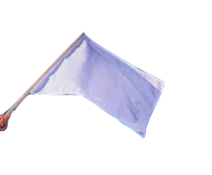
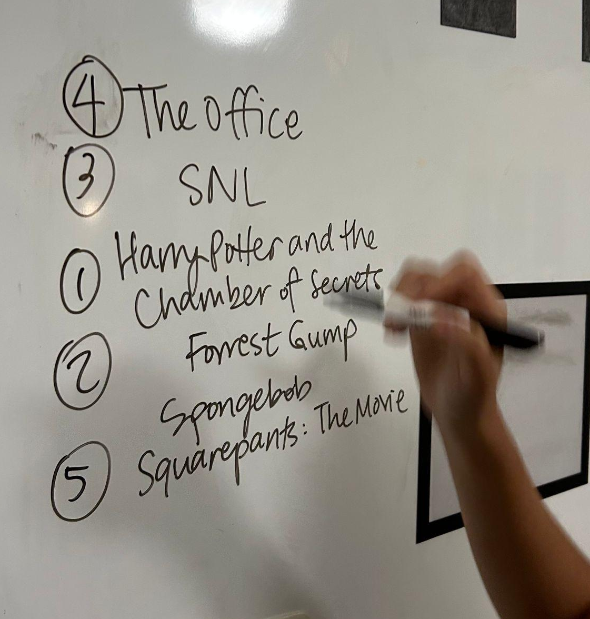




Reel Ranker
1st?
Key Assumption
3rd?
2nd?
Ranking shows is enjoyable
4th?
Methodology
5th?
Ask participant to…
List 5 shows/movies
Rank them (by preference)
Rate
  fun
  difficulty
  interest in others’ rankings

Slide 45
Results

Slide 46
Results
What worked
Interest in viewing friend’s rankings
High willingness to complete this task

Slide 47
Results
What worked
What didn’t work
Interest in viewing friend’s rankings
Participants felt neutral about the activity
High willingness to complete this task
Listing 5 shows took more thought/ effort than ranking

Slide 48
Results

Slide 49
Results
Surprises
People found it easier to pick least favorite first
People mentioned using friend’s rankings to avoid bad content
People took into account political correctness/ethics when ranking

Slide 50
Results
Surprises
New Learnings
People found it easier to pick least favorite first
People are most interested in friends’ ranking of shared shows/movies
People mentioned using friend’s rankings to avoid bad content
Thinking of 5 shows/movies at once could be overwhelming
People took into account political correctness/ethics when ranking

Slide 51
Results
Surprises
New Learnings
People found it easier to pick least favorite first
People are most interested in friends’ ranking of shared shows/movies
People mentioned using friend’s rankings to avoid bad content
Thinking of 5 shows/movies at once could be overwhelming
People took into account political correctness/ethics when ranking
Validity
Revised Assumption:
Ranking shows could be enjoyable if shared with friends.

Slide 52
How Might We…
encourage people to break out of their typical bubbles of entertainment media consumption?

Slide 53
Solution #2

Slide 54
How Might We…
encourage people to break out of their typical bubbles of entertainment media consumption?
A media scavenger hunt app where users watch unfamiliar movie/TV to progress through the levels and win rewards & recognition upon progressing through the hunt.

Slide 55
Prototype #2:
Risky Rewards

Slide 56
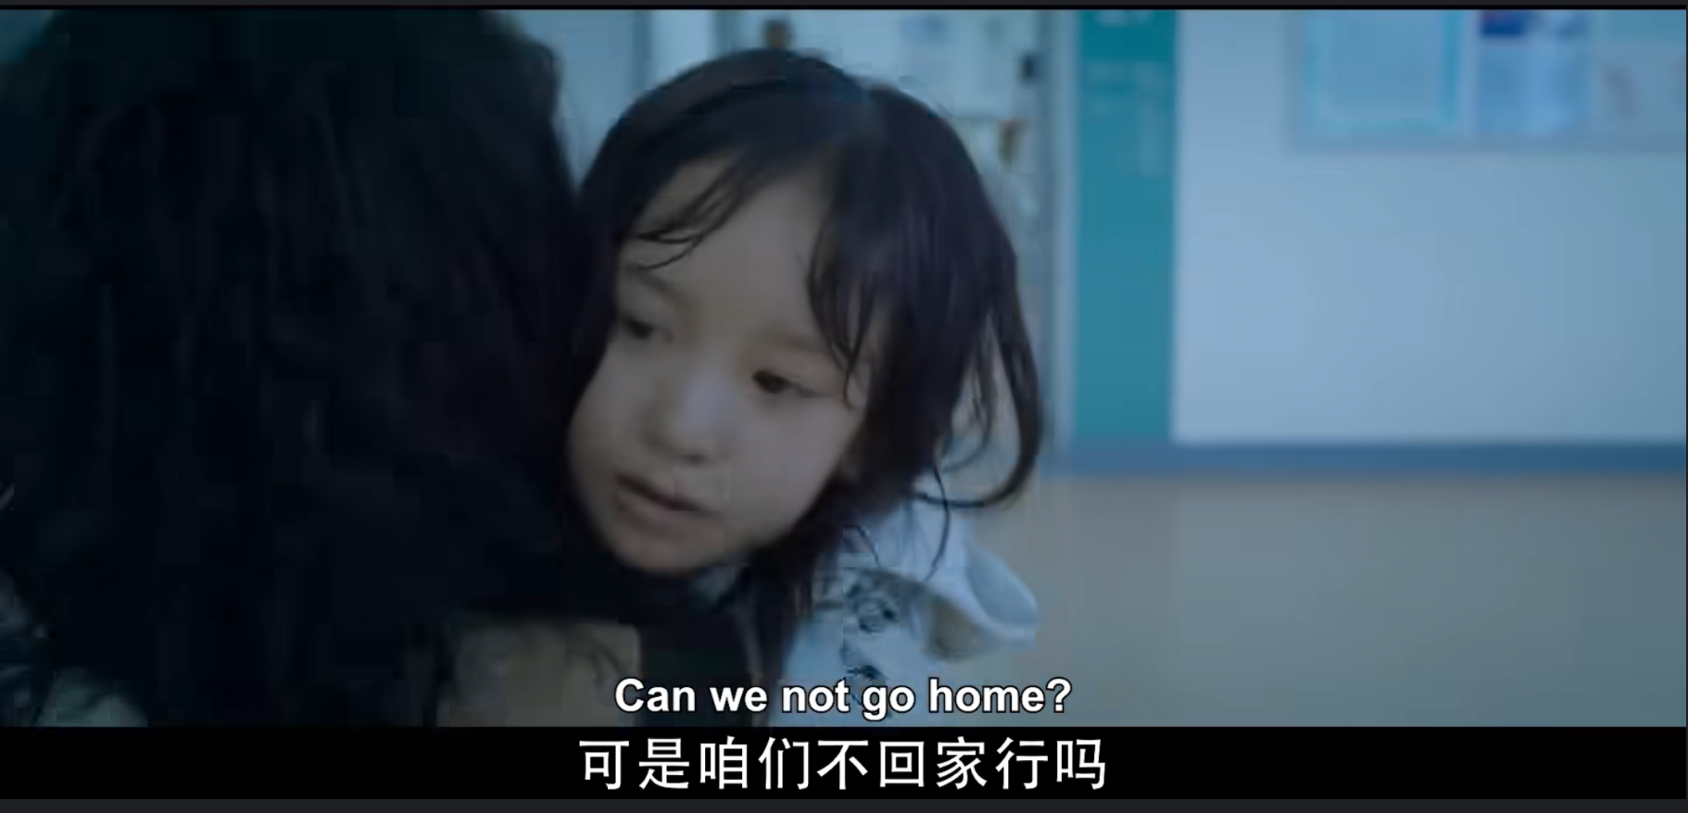
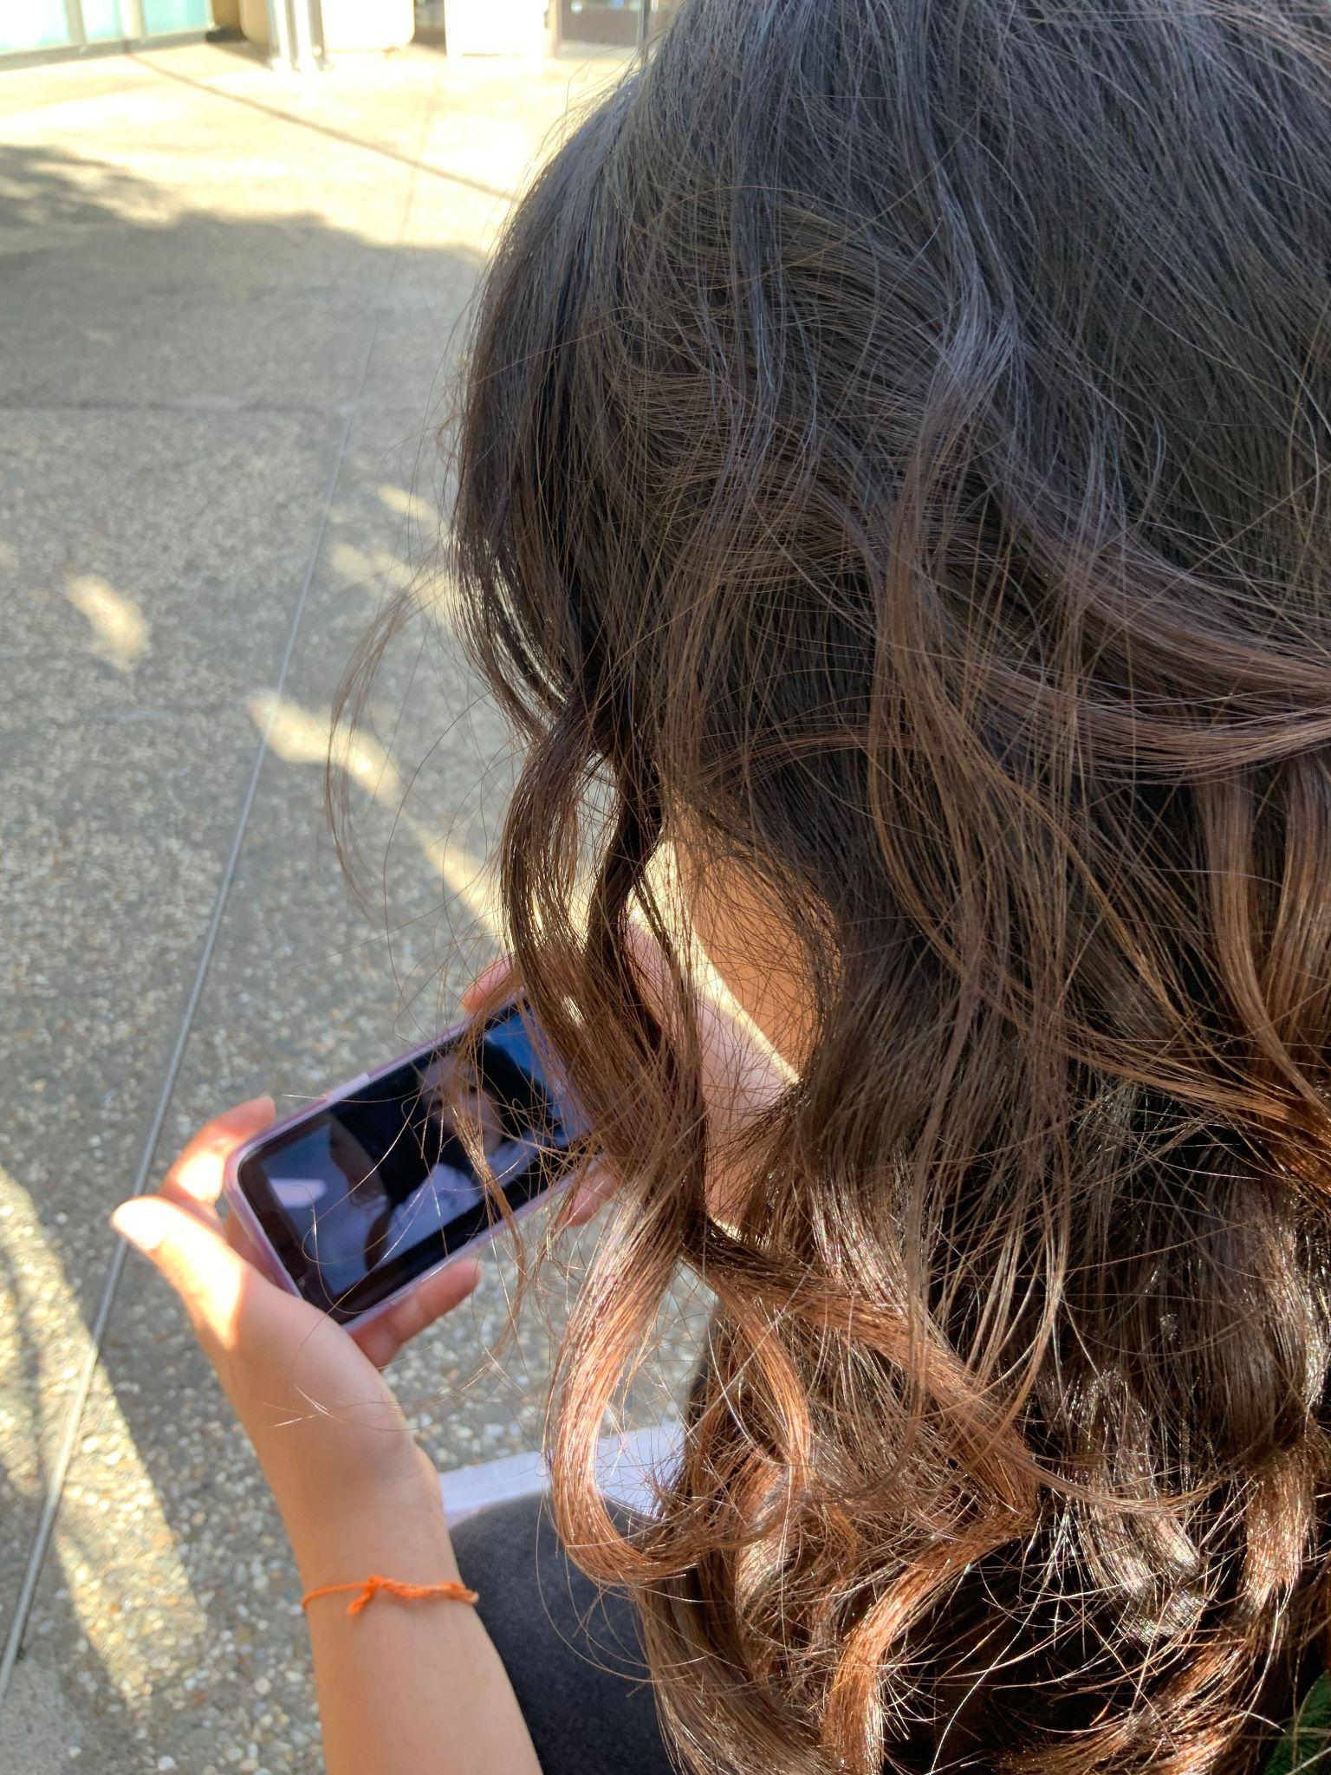

Prototype #2: Risky Rewards
Key Assumption
People will give unfamiliar shows/movies a chance if they receive rewards in return
Methodology
Ask participant to…
Watch a snippet of video content outside of usual repertoire for a chance to win a gift card
Rate:
  Enjoyment
  Curiosity
  How likely to continue watching
$10?

Slide 57
Results

Slide 58
Results
What worked
People were willing to watch new/unfamiliar content for $
Some reacted positively to the content

Slide 59
Results
What worked
What didn’t work
Most said they would not continue to watch the content
People were willing to watch new/unfamiliar content for $
Some reacted positively to the content
Some types of content are inherently more intriguing
One could watch without actually watching

Slide 60
Results

Slide 61
Results
Surprises
Some revealed they would have done the task without reward
Some mentioned they usually only have time for short clips

Slide 62
Results
Surprises
New Learnings
Some revealed they would have done the task without reward
Rewards facilitate action but not necessarily interest
Some mentioned they usually only have time for short clips
One could find the short clip enjoyable and not want further interactions due to other priorities

Slide 63
Results
Surprises
New Learnings
Some revealed they would have done the task without reward
Rewards facilitate action but not necessarily interest
Some mentioned they usually only have time for short clips
One could find the short clip enjoyable and not want further interactions due to other priorities
Validity ✅
Revised Assumption:
Reward is effective for short term motivation but not for building lasting passion and openness for new content

Slide 64
How Might We…
create a safe space where people can be proud of their preferences in entertainment media?

Slide 65
Solution #3

Slide 66
How Might We…
create a safe space where people can be proud of their preferences in entertainment media?
A media sharing app that automatically shares what users are watching and their location with friends on a map. It enables users to ping each other, arrange virtual or in-person watch sessions, and suggests content based on user and friend preferences.

Slide 67
Prototype #3:
Message-a-muddy
(aka movie buddy)

Slide 68
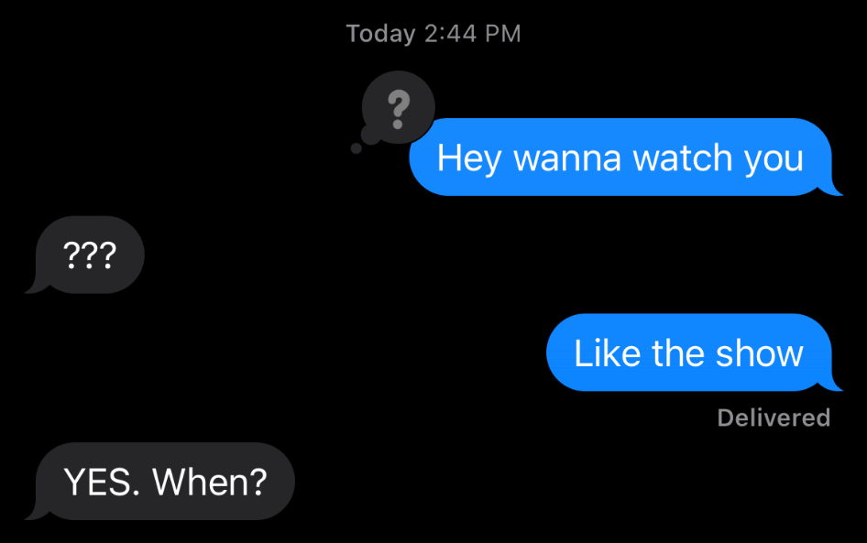
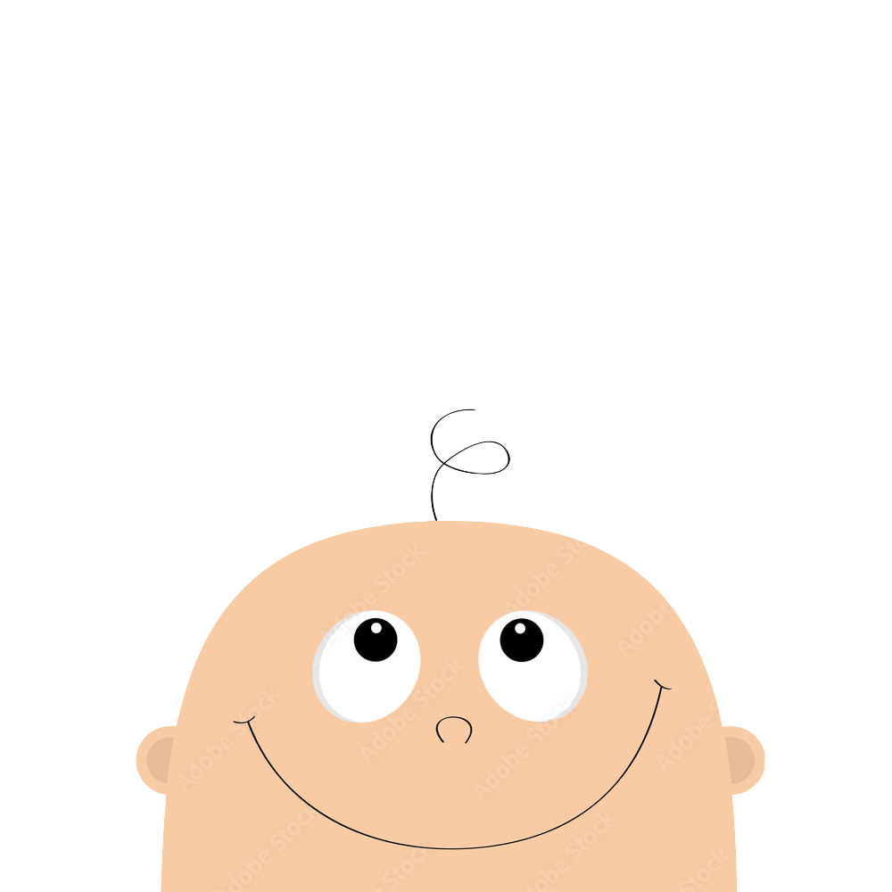
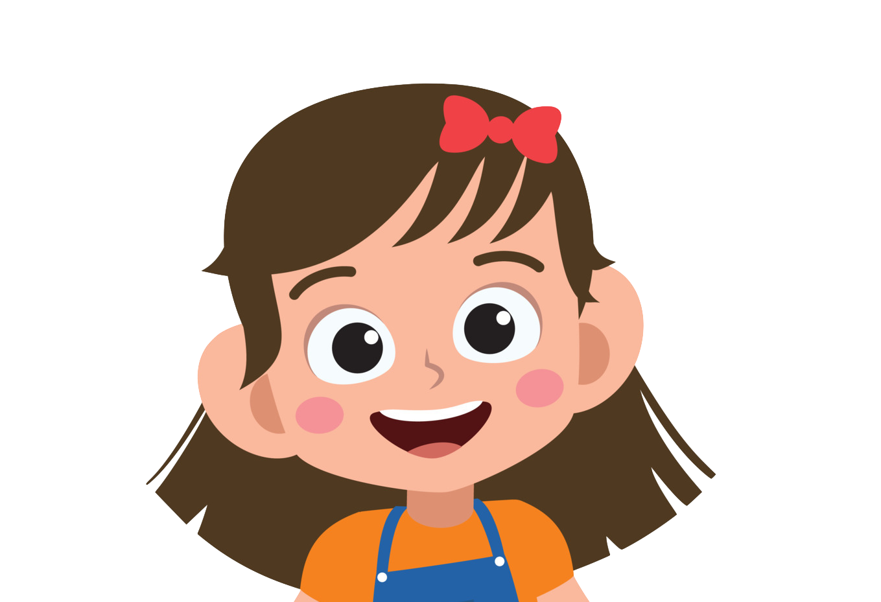
Prototype #3: Message-a-muddy (movie buddy)
Key Assumption
People are comfortable reaching out to friends about watching shows together
Methodology
Ask participant to…
Reach out to person/group to schedule a watching session
Then, ask about:
  Who? Why?
  Comfort
  Usual Frequency

Slide 69
Results

Slide 70
Results
What worked
Most felt comfortable reaching out to friends to schedule watch session
Most do reach out to close friends in everyday life to watch shows to some extent

Slide 71
Results
What worked
What didn’t work
Most felt comfortable reaching out to friends to schedule watch session
People only chose people they were most comfortable with even though they may have wanted to reach out to someone else
Most do reach out to close friends in everyday life to watch shows to some extent

Slide 72
Results

Slide 73
Results
Surprises
Many already had plans to watch shows with friends
Those with partners have built in watch buddy but struggle more with finding shows
Avg level of comfort is higher than frequency of reaching out

Slide 74
Results
Surprises
New Learnings
Many already had plans to watch shows with friends
Alone or group depends heavily on environment & situation
Those with partners have built in watch buddy but struggle more with finding shows
Access (to projector, streaming platform etc.) matters
Scheduling watching is harder than say a meal because of time-restraints & comfort level
Avg level of comfort is higher than frequency of reaching out
Notes:
desire vs action gap

Slide 75
Results
Surprises
New Learnings
Many already had plans to watch shows with friends
Alone or group depends heavily on environment & situation
Those with partners have built in watch buddy but struggle more with finding shows
Access (to projector, streaming platform etc.) matters
Scheduling watching is harder than say a meal because of time-restraints & comfort level
Avg level of comfort is higher than frequency of reaching out
Validity ✅
Revised Assumption:
People are comfortable reaching out to CLOSE friends about watching shows together

Slide 76
Watching roulette app where when you don’t know what to watch, they have a roulette option that throws you into a random, well-rated show
Approaching a Solution

Slide 77
Watching roulette app where when you don’t know what to watch, they have a roulette option that throws you into a random, well-rated show
Solution

Slide 78
Watching roulette app where when you don’t know what to watch, they have a roulette option that throws you into a random, well-rated show
Solution
#1 Reel Ranker
✅ Curiosity about friends’ preferences
❌ Fun Enough; Takes Effort

Slide 79
Watching roulette app where when you don’t know what to watch, they have a roulette option that throws you into a random, well-rated show
Solution
#1 Reel Ranker
✅ Curiosity about friends’ preferences
❌ Fun Enough; Takes Effort
#2 Risky Reward
✅ $ help people watch new things
❌ pique enough long-term interest

Slide 80
Watching roulette app where when you don’t know what to watch, they have a roulette option that throws you into a random, well-rated show
Solution
Combined Solution
#3 Movie Buddy + Mapping & Reward
✅ Simple Interactions
✅ Highly demanded between close friends
#1 Reel Ranker
✅ Curiosity about friends’ preferences
❌ Fun Enough; Takes Effort
#2 Risky Reward
✅ $ help people watch new things
❌ pique long-term interest

Slide 81
Watching roulette app where when you don’t know what to watch, they have a roulette option that throws you into a random, well-rated show
Solution
Combined Solution
#3 Movie Buddy + Mapping & Reward
✅ Simple Interactions
✅ Highly demanded between close friends
#1 Reel Ranker
✅ Curiosity about friends’ preferences
❌ Fun Enough; Takes Effort
#2 Risky Reward
✅ $ help people watch new things
❌ pique long-term interest
Communities Left Out: People who do not use media entertainment platform at all, people who do not have friends to watch media with, people who cannot access devices

Slide 82
Key Learnings

Slide 83
Key Learnings
Community
Community and quality interactions enhance media consumption.

Slide 84
Key Learnings
Community
Connection
Community and quality interactions enhance media consumption.
Stress-free sharing and close connections amplify enjoyment.

Slide 85
Key Learnings
Community
Connection
Consistency
Community and quality interactions enhance media consumption.
Stress-free sharing and close connections amplify enjoyment.
Continuous and genuine engagement builds lasting passion beyond initial rewards.

Slide 86
Next Steps
Notes:
More interviews? -> Diversify the age group and gender group

Slide 87
Next Steps
Brainstorm Tasks
01
Work on combing what worked to achieve high-level user goals
Notes:
More interviews? -> Diversify the age group and gender group

Slide 88
Next Steps
02
Concept Video
Brainstorm Tasks
01
Work on combing what worked to achieve high-level user goals
Give a visual introduction to our solution
Notes:
More interviews? -> Diversify the age group and gender group

Slide 89
Next Steps
02
Concept Video
03
Brainstorm Tasks
Exploration
01
Work on combing what worked to achieve high-level user goals
Give a visual introduction to our solution
Start building website and think about the look and feel of our app
Notes:
More interviews? -> Diversify the age group and gender group

Slide 90
Thank You!
Any Questions?

Slide 91
Appendix

Slide 92
HMW Brainstorm 1
WE MET David, an outdoorsy skateboarding enthusiast who claims to be “social media anti-social” and didn’t carry any electronics with him. WE WERE SURPRISED TO FIND he doesn’t find most mainstream media interesting but claims to have seen every skateboarding crash and burn video online. WE WONDER IF THIS MEANS even those who show little interest in media entertainment in general still love consuming content for hobbies they are truly passionate about. IT WOULD BE GAME-CHANGING IF there is a way for him to access only content that he is interested in.
FILTER CONTENT
HMW filter out irrelevant content?
HMW make sorting through content effortless?
HMW ensure users find their passion-related content amidst the digital noise?
LEARN MORE ABOUT CONTENT
HMW know what types of video people find interesting/uninteresting?
HMW learn more about content he is currently exposed to?
EXPOSURE TO NEW/OTHER CONTENT
HMW make David & others like him open to different kinds of content?
HMW make David & others like him passionate about other things?
GENERAL MEDIA
HMW make non-engagement with digital media undesirable?
HMW get rid of some of the stigma around consuming media (vs being outdoorsy)?
COMMUNITY
HMW give him another way to interact with content or individuals who share this passion?
MAKE MEDIA EXPERIENCE MORE POSITIVE/INTEGRATED INTO HIS LIFE
HMW make media consumption more enjoyable for outdoorsy people?
HMW reframe general media consumption as a good thing that is worth his time?
HMW ensure that the digital experience is enriching for everyone?
HMW have media consumption not interfere with outdoor time?

Slide 93
HMW Brainstorm 2
WE MET Collin, a married middle-aged college consultant who almost exclusively consumes video content alone or with his wife. WE WERE SURPRISED TO FIND that he enjoys watching sports with a larger group of friends. WE WONDER IF THIS MEANS certain types of media are more enjoyable when consumed socially compared to other types of digital video content.IT WOULD BE GAME-CHANGING IF social experiences could be facilitated for all types of digital video content.
Enhance the group watching experience
HMW make it more fun to consume media as a group?
HMW make group interactions revolve around media?
HMW make media interactions revolve around groups?
HMW make it easier to watch things with friends?
Find groups for people
HMW get people regular friend groups to watch things with?
HMW make Collin feel as group-oriented about other forms of media?
HMW allow people to enjoy different types of media with different groups?
HMW help him get to know more people who are also interested in watching sports together?
Find good group-watching media
HMW figure out which types of content is more enjoyable in a social context?
HMW sort between media that’s better for group watching?
HMW make it easier for people to access media that they find most enjoyable?
HMW make all content, not just sports, sociable?
Enhance the watching experience even when alone
HMW make media consumption more enjoyable when a person’s physically alone?
HMW make a sport-watching experience fun even when the person is alone?

Slide 94
HMW Brainstorm 3
WE MET DJ, a father in his early thirties with Disney tattoo sleeves and media-related posters and action figure toys lining his office. WE WERE SURPRISED TO FIND that he didn’t actively share his media passions (Marvel, Star Wars, Disney), despite being passionate enough to line his body and office with media-related content. WE WONDER IF THIS MEANS DJ feels as though others aren’t as passionate as he is about his interests, and therefore he feels they wouldn’t want to hear about them. IT WOULD BE GAME-CHANGING IF DJ and other like him had a way to connect with others who wanted to hear about their passions and felt safe to do so without fear of judgment
CONNECTING THOSE WITH SHARED PASSIONS
HMW incentivize people to connect with those who share similar interests?
HMW connect people to others that are as passionate about something as they are?
HMW get DJ excited about finding others that share his content interests?
CONNECTING THOSE EVEN WITH DIFFERENT PASSIONS
HMW incentivize people to connect with one another even if they don’t have the same interests?
INTERNAL POSITIVITY (EX BOOST CONFIDENCE)
HMW make DJ & those like him feel more confident in sharing his interests?
HMW help people to feel comfortable and confident in their interests/passions?
HMW get DJ to give people the benefit of the doubt?
MINIMIZE JUDGEMENT
HMW teach people to be less judgemental about what others enjoy?
HMW build a safe space for people to share their true passion?
HMW keep negative people away from DJ?
SWAY OPINIONS ABOUT INTERESTS
HMW get DJs family interested in his interests?
HMW make people as passionate as DJ is about what they consume?
HMW get people to be interested in DJs stuff?
REBRANDING OF NERDY
HMW rebrand typically nerdy things as cool?
HMW get everyone to be as nerdy as DJ?
TANGENTIAL TERRITORIES
HMW make what comes after the media consumption more exciting for casual viewers?

Slide 95
Solution Brainstorm 1: HMW make all entertainment media consumption as group-oriented as sports media?
Gamify movies
A game app where you show snippets of movies that you’ve all watched, and have everyone try to guess what show/movie it was
An app where we gamify the viewing experience where friends can do challenges together while watching (I’m thinking drinking games) (this is a sick pregame)
Find companions
An app to schedule local gatherings for those who are particularly interested in specific shows/movies
An app for solo movie goers to connect with one another
An AI VR dog that watches movies with you
Movie social media, see what your friends are watching/join/comment
An app for friend groups where you can see what your friends are watching/have watched so you can talk about it
An app where you can see what friends are watching and join them or comment on their show easily. / rank shows and see others’ rankings so you have an easy way of starting a conversation over same/different opinions.
An app with live chat rooms/comment features for when new episodes of shows air (both live and on streaming platforms).
Movie suggestion methods/algorithms
An app that suggests which movie to watch based on two people’s preferences, solves the “What do we watch?” problem
Suggests movies/shows to watch based on how you’re feeling, or specific moods, like Spotify’s recommendation algorithm/DJ
An app where AI finds you people who have very similar watching taste as you so can connect and recommend each other shows
An app where friends can schedule watching session together easily
Dating/friend app based on what you like to watch
Something that looks at what movies your friends have enjoyed, and suggests movies to watch based on that

Slide 96
Solution Brainstorm 2: HMW encourage people to break out of their typical bubbles of entertainment media?
Gamify movies
A game app that tests your knowledge in shows, but has ad breaks, except the ads are just snippets of the most exciting parts of random shows.
Movie suggestion methods/algorithms
Movie suggestion algorithm that finds movies that are in different genres, but are similar to something you’ve enjoyed
An app that shows you little snippets of movies that you might find interesting, like what TikTok/Reels/Shorts does, and you can watch those movies if you want to
Watching roulette app where when you don’t know what to watch, they have a roulette option that throws you into a random, well-rated show, without you knowing what show it is.
Shows by foreign cultures, perhaps in different languages, they may add subs/dubs to the movie and encourage you to watch it
Find new Movies/Genres in an interesting way
A map of all movies, connected together in a graph, grouped by their similarity, and you can see exactly which “bubble” you’re in, and potentially explore movies inside that bubble, you can see actors which have acted in those movies and others, etc., etc., check out https://everynoise.com/ (similar thing but for music)
Reward Watching (Sponsored) Movies
An app, sponsored by the movie (so that less known movies can promote themselves), that rewards the user every time they watch something that is different from their usual taste.
You get a care package with a new movie series, new book series (Hello Fresh but with media), digital care package
Keep a pet, you take care of the pet by watching movies that they suggest, you earn items, etc
Explore Movies as part of a goal
Scavenger hunt where you watch movies to progress through the hunt, can do it with friends/opponents
Calendar that tells you which movies came out on that day (can be for prompt below )
Movie map where every time you pass by somewhere something was filmed, you get a notification with info and snippets of that content to pique your interest
Popeup exhibits to reach wide range of audience

Slide 97
Solution Brainstorm 3: HMW create a safe space where people can be proud of their preferences in entertainment media?
Social
An app that connects people with niche interests together and allows individuals to easily find the groups that share their taste in entertainment media
An app where people can easily post what they’re watching to a friend group/chat (to get over the barrier/fear of sharing that part of them)
Reddit, but for movies (people can create spaces/chats/forums where they can discuss movies they’ve watched, they can set their own moderators, etc)
Summary/Stats for Sense of accomplishment
An app that can create positive feedback on people’s taste in media entertainment. For example, sending people a short report on how they are special but also there are xxx% of the people who share this same interest. (Netflix Wrapped)
An app that keeps track of all the shows you’ve watched so it’s like collecting collectibles and people can feel proud about their collection.
Art
Fan art sharing platform, positive stuff only
User-Generated Content Challenges: Host challenges and competitions for users to create content related to their favorite entertainment. This could be anything from fanfiction contests to cosplay showcases, fostering creativity and a sense of community.
Reward
Platform where marketing teams for shows can connect with fans who are willing to promote the show and have giveaways/exclusive content in return

Slide 98
Assumptions Brainstorm
# Solution 1
people have friends
people care about what others are watching
people would take the effort to share
people would take the effort to add and rank shows they’re watching
it is so easy to use that people would like to schedule group watching sessions on this app rather than just texting and asking.
The shared passion will lead people to share despite the awkwardness that they are strangers
people will likely to share real time with each other about new episodes
people will want to compare rankings of media
people will have strong opinions about some of their friends’ posts
differing rankings will facilitate conversations
Ranking is a fun activity for people
# Solution 2
movie producers have money/would want to spend money on promoting,
watchers will actually watch the videos instead of letting them play
rewards satisfy users’ wants or needs/users are actually interested in getting these reward
People are completionists at heart (activate the gotta catch em all reflex)
People can keep track of what they’ve seen, and are more likely to if it’s passive
People will give new things a try if there’s something in it for them
# Solution 3
people are willing to add all the entertainment content that they’ve watched
people would appreciate the achievement and reports they receive
People will be more willing to participate if they can hide their identity
People will be more willing to participate if they can interact with others participating
People like winning things
People are comfortable reaching out to friends about watching shows together

Slide 99
Credits
This presentation template was created by Slidenest, using resources from these sites:
Images
https://unsplash.com/es/fotos/VnfqkxCSCrU
https://unsplash.com/photos/tZc3vjPCk-Q
https://unsplash.com/photos/pl9DrjAMV6I
https://unsplash.com/es/fotos/TCeSrR11chw
https://unsplash.com/photos/wKOKidNT14w
https://unsplash.com/photos/OpgJPy3zjDE
https://unsplash.com/es/fotos/ZdUNNTZdHag
https://dribbble.com/shots/12047781-Digital-Agency-Hero
https://dribbble.com/shots/21782982-Softphone-App-wip-p2
Fonts
Playfair Display: https://fonts.google.com/specimen/Playfair+Display
Montserrat: https://fonts.google.com/specimen/Montserrat

